Slide 1
Time Scheduling
using Graph Coloring
PRESENTER:
Malepati Haneesh - 2010030323
Mounika Kolli - 2010030384
Lahari Pydikondala - 2010030372
Rithvik - 2010030421
UNDER THE GUIDANCE OF:
Udaya Rani Gurala

Slide 2
INDEX
INDEX
Topics Covered
1. ABSTRACT
2. INTRODUCTION
3. PROBLEM STATEMENT
4. ALGORITHM
5. FLOWCHART
6. NUMERIC EXAMPLE
7. GITHUB SETUP
8. DIVISION OF WORK

Slide 3
ABSTRACT
A graph coloring is the process of assigning labels to the vertices of a graph in such a way that no two adjacent vertices have the same color. Graph coloring has many real-time application including map coloring, scheduling problem, network design etc. We choose scheduling Application as making Exam time-table is required in every educational institution. In every semester the universities are required to generate exam time - table for conducting exam.

Slide 4
INTRODUCTION
• A schedule is desirable which combines resources like teachers, subjects, students, classrooms in a way to avoid conflicts satisfying various essential and preferential constraints.
• Graph coloring is one such heuristic algorithm that can deal timetable scheduling satisfying changing requirements.
• Here we will use vertex coloring as the graph coloring for our scheduling problem.
THIS IS OUR VISON
Presentations Templates are communication tools that can be used as lectures, reports, and more.
It serves a variety of purposes, making presentations powerful tools for convincing and teaching.

Slide 5
PROBLEM STATEMENT
The presence of large number of students and large number of offered courses sometimes make it difficult to schedule the exam without having any conflict.Generating exam time table is very time consuming.
In this problem, We should also consider those students who have back papers and thus, need to reappear in some of the papers. The exam time table should avoid such conflicts, like no two or three exams for the identical student should be scheduled at the same period of time. Therefore, there is a much need of an effective and accurate timetable to the performance of any educational institute.Graph coloring is a method of assigning colors to certain elements of a graph subjected to certain constraints.

Slide 6
ALGORITHM USED:
Graph Coloring Algorithm:
Input: The course conflict graph G thus obtained act as the input of graph coloring
algorithm.
Output: The minimum number n of non-conflicting time-slots required to schedule
courses
Step 1: Input the conflict graph G.
Step 2: Compute degree sequence of the input conflict graph G.
Step 3: Assign color1 to the vertex vi of G having highest degree.
Step 4: Assign color1 to all the non-adjacent uncoloured vertices of vi and store
color1 into Used_Color array.

Slide 7
Step 5: Assign new color which is not previously used to the next uncoloured vertex
having next highest degree
Step 6: Assign the same new color to all non-adjacent uncoloured vertices of the
newly colored vertex.
Step 7: Repeat step-5 and step-6 until all vertices are colored.
Step 8: Set minimum number of non-conflicting time-slots n= chromatic number of
the colored graph=total number of elements in Used_Color array.
Step 9: End

Slide 8
FLOWCHART
If(two Schedule time matchs)
No
Create a Schedule Model
Start
Input Data
Schedule table
Yes
END
Display the Model
Update the Model

Slide 9
EXAMPLE PROBLEM
We have given the following information, with core subjects, elective subjects and arrear papers.
i)First semester subjects :Real analysis (RA), Ordinary differential equations(ODE), Graph theory(GT),Autometa theory(AT), Applied statistics(AS).
ii) Third semester subjects :Big data analysis(BA), Topology(TO), Statistical inference(SI), Fluid dynamics(FD), RA,ODE,AS. Note: RA,ODE and AS are the first semester subjects. However, we are adding the subjects in the third semester because we are assuming that some third semester students have got arrear paper in these three papers and thus need to reappear.

Slide 10
ii) Fifth semester subjects: Pesource management techniques(RMT), Mathematical methods (MA), Numerical analysis (NM).a. Note: ODE, FD are first and third semester subjets.
However, we are assuring that some fifth semester students have arrear papers in these subjects and thus need to reappear.This information given to us.We are ask to make exam time table so that no student have two or more subject exam at same time. And also ask to give total

Slide 11
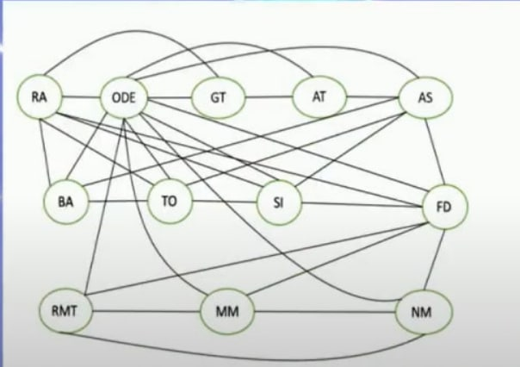
For solving this problem, We make vertices of total number of subject. And assign every vertex to one subject. Then we make edge between all subject of every semester. Eg. ODE is in all semester so that ODE vertex is connected to all other vertices of the graph .GT is only in first semester so that GT vertex connected to only first semester subject vertices After doing this we get this type

Slide 12
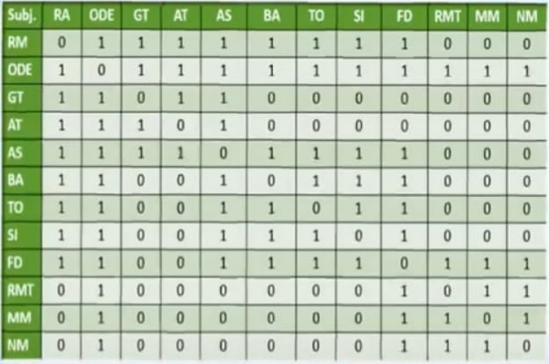
After forming of graph we get a adjacency matrix which is shown below

Slide 13
In this problem we are assign color to the subjects based on the course matrix. Two courses are said to be collide other if they are adjacent. No two adjacent courses are same color. In table 5, we observe the first row we see that RA and ODE could not be assigned in same color since they are adjacent. However, RA and RMT could be assigned the same color since they are not adjacent.,We assign every color to number like this [1=Red, 2=Violet, 3-Blue, 4=Green,5=Pink, 6-Yellow, 7-Orange ].Since, we are start subject with Real Analysis (RA); we assign color 1 to it.

Slide 14
Now, we check the second row of the course matrix. Subject RA is adjacent to ODE. Thus we need to assign a different color to ODE and we assign color 2.it is shown in table.
Now, we check the third row of the course matrix where GT is adjacent to both RA and ODE. So, we assign a new color to GT. Itis shown in table

Slide 15
Finally after observing the twelve row of the course matrix,NM is being assigned the color which was previously assigned to AT. It is shown in table.
For this case study, the number of subjects may be less, but in practical scenario sorting the subjects based on color values will enhance the computational performance. So, by considering the same example, after sorting the list of subjects are arranged in the following form which given in table.

Slide 16
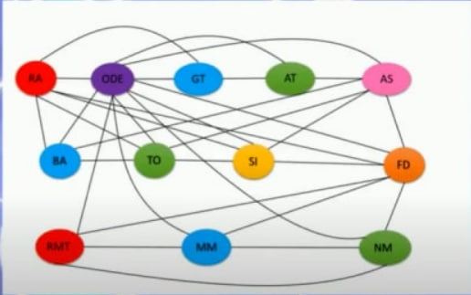
We finally get coloured graph as below

Slide 17
Work Progress:-
Completed:-
Python code for graph colouring
TODO:-
Making table out of graph

Slide 18
Work Division:-
Mounika – Documantation and Code
Lahari – Python code and FrontEnd
Rithvik – BackEnd and Documantation
Haneesh - Testing

Slide 19
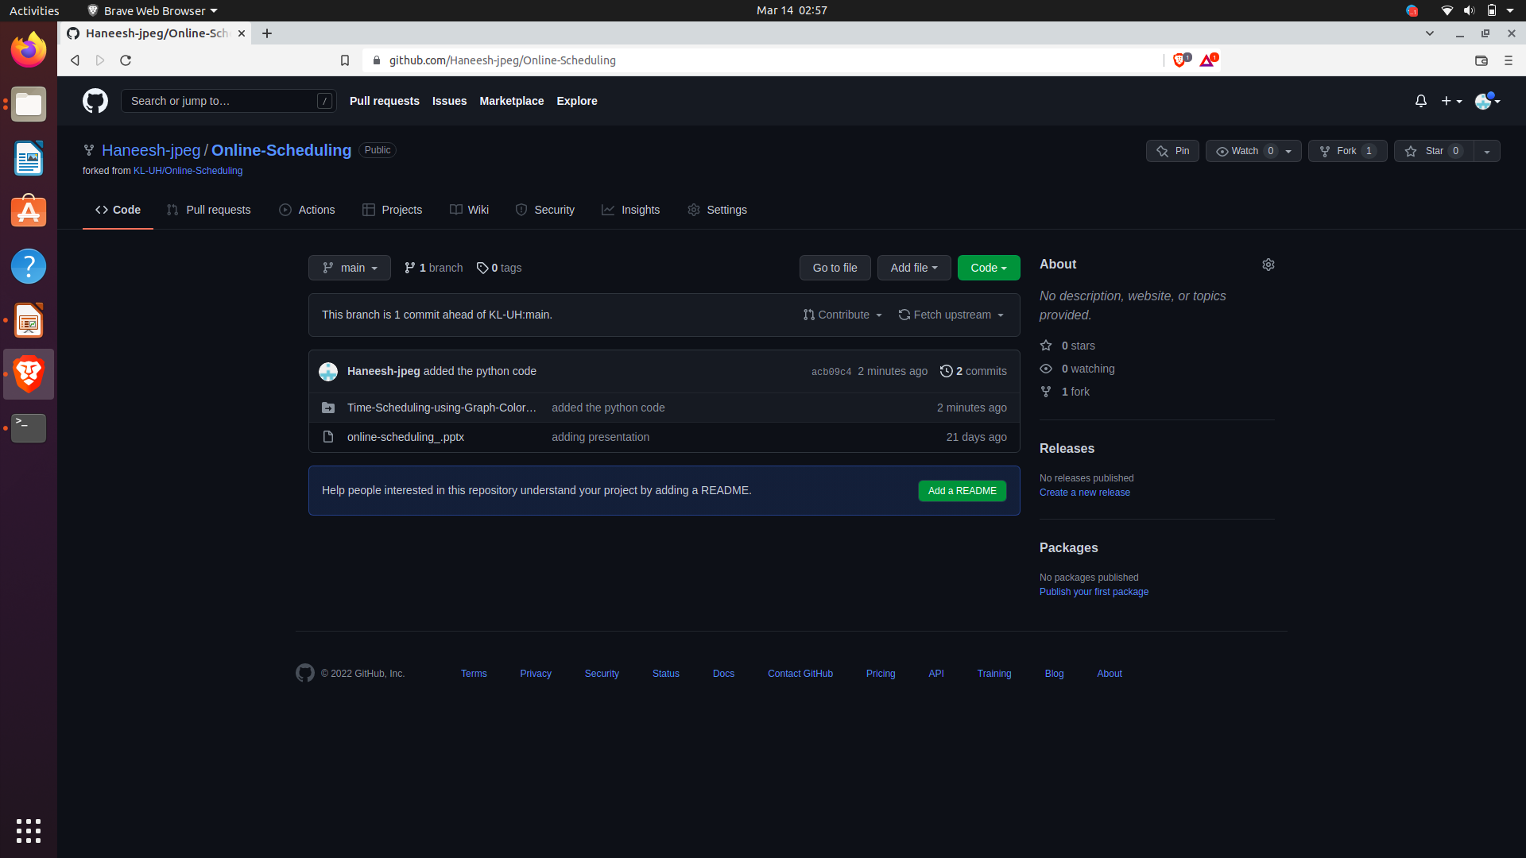
GitHub Commits :-

Slide 20
Thank You

